Slide 1

Sterile Neutrinos
"The existence of hundreds of new particles may seem far fetched, but is in principle not impossible.”
(Boyarski et al. 2018)
Antoniadis, Carreira, & Karchev. GRAPPA Student Seminar (2019)

Slide 2
Motivation

Slide 3
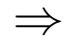
Neutrinos
Electrically neutral
Only interact weakly
Long-living
Oscillate Massive DM candidate?

Slide 4
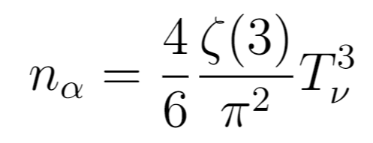
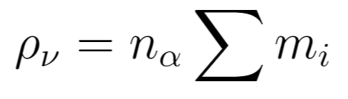
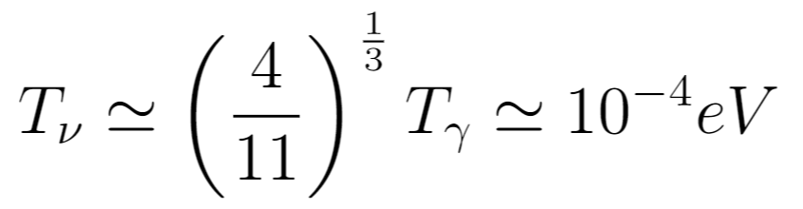
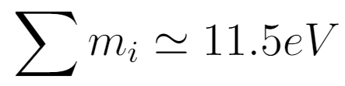
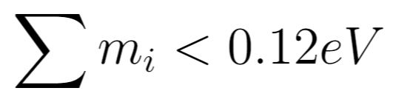
Neutrinos
_ ,
_
DM candidates
But

Slide 5
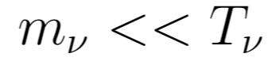
Neutrinos
_
Hot DM
Neutrinos decouple relativistic
No time for large structure formation

Slide 6
Neutrinos
_
Hot DM
Not a viable DM candidate

Slide 7
Neutrinos
_
Hot DM
Not a viable DM candidate
The SM does not contain a viable DM candidate

Slide 8
“particles that are, from the point of view of ordinary weak interactions, sterile, i.e. practically unobservable, since they have the “incorrect” helicity”
(Bruno Pontecorvo, 1967)

Slide 9
Sterile neutrinos
With a mass of a few keV, sterile neutrinos could make up all DM
Could also solve the neutrino mass problem

Slide 10
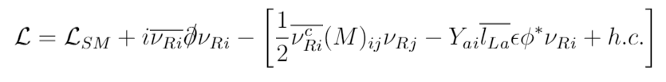
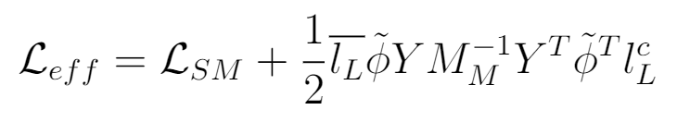
Sterile neutrinos
__
At low energies,
Kinetic
Majorana
Interactions

Slide 11
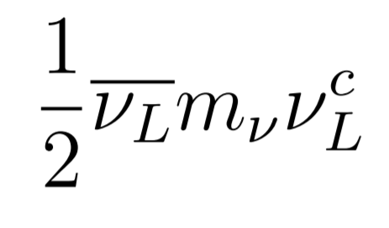
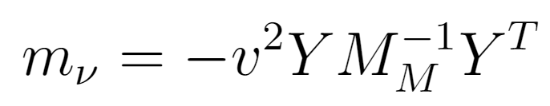
Sterile neutrinos
__
The Higgs mechanism then generates a Majorana mass term of the form
With
Seesaw mechanism

Slide 12
Sterile neutrinos
__
The Higgs mechanism then generates a Majorana mass term of the form
With
Seesaw mechanism

Slide 13

Seesaw mechanism

Slide 14
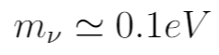
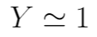
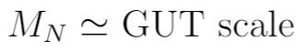
Seesaw mechanism

Slide 15
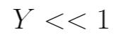
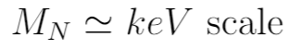
Seesaw mechanism
(Dark Matter)

Slide 16
Production mechanisms

Slide 17
Thermal Production via Mixing ("freeze in")
Non-resonant Production
Resonant Production
Thermal Production via New Gauge Interactions ("freeze out")
Non-thermal Production in the decay of heavier particles

Slide 18
Thermal production via mixing ("freeze in")​
Weak interaction​
Active-sterile mixing (seesaw model)
​
$$\left|ν_{a}\right\rangle =\cos{θ}\left|ν_{1}\right\rangle +\sin{θ|ν_{2}⟩}$$
$$\left|ν_{s}\right\rangle =−sin{θ}\left|ν_{1}\right\rangle +\cos{θ|ν_{2}⟩}$$

Slide 19
Non-resonant production
Coherent oscillations between active and sterile states
Decoherent scatterings
Destroy the coherence of the quantum state
Force it into weak interaction
$$\left|ν_{a}\right\rangle =\cos{θ_{m}\left(t\right)}\left|ν_{1}\left(t\right)\right\rangle +\sin{θ_{m}\left(t\right)|ν_{2}\left(t\right)⟩}$$
$$\left|ν_{s}\right\rangle =−sin{θ_{m}\left(t\right)}\left|ν_{1}\left(t\right)\right\rangle +\cos{θ_{m}\left(t\right)|ν_{2}\left(t\right)⟩}$$
$$Γ∼G_{F}^{2}T^{5}\frac{\sin^{2}{2θ}}{\sin^{2}{2θ}+{\left[\cos{2θ+{\left(\frac{T}{T_{0}}\right)}^{4}}\right]}^{2}}$$
Notes:
the temperature of the primordial plasma changes due to Hubble expansion

Slide 20
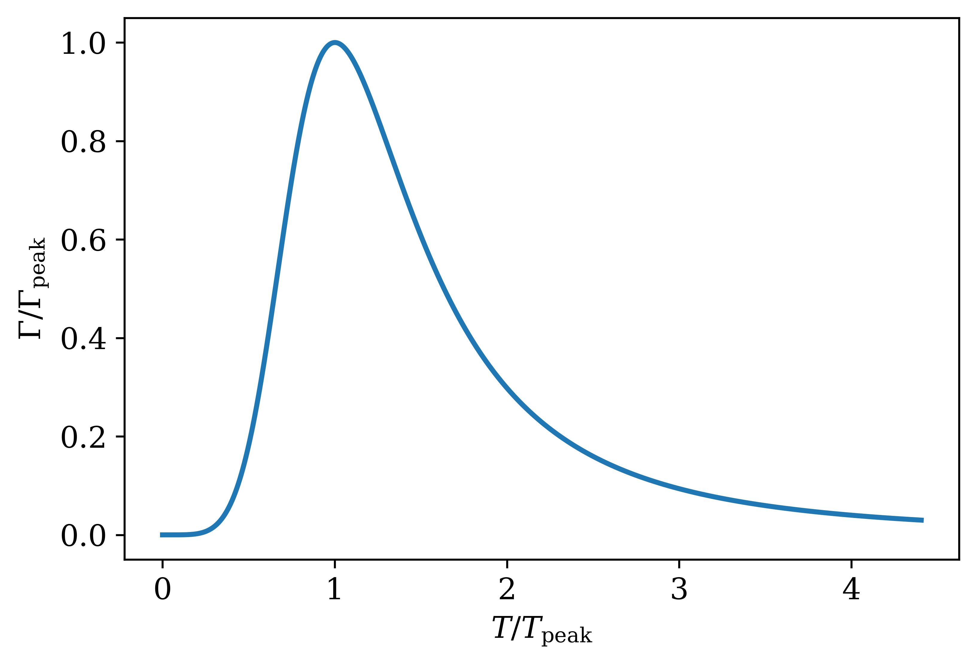
$$Γ∼G_{F}^{2}T^{5}\frac{\sin^{2}{2θ}}{\sin^{2}{2θ}+{\left[\cos{2θ+{\left(\frac{T}{T_{0}}\right)}^{4}}\right]}^{2}}$$
$$T_{peak}≈133 MeV {\left(\frac{M}{1 keV}\right)}^{1/3}$$
$$∝T^{5}$$
$$∝T^{−3}$$

Slide 21
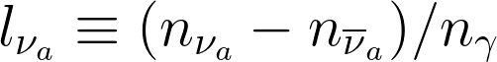
Resonant production
Lepton asymmetries
Mikheyev–Smirnov–Wolfenstein (MSW) effect
Enhances the transition between two kinds of neutrinos in a changing lepton density
Disfavoured by constraints from Lyman-α forest, dwarf galaxy number counts and X-ray data
Uncertain how large lepton asymmetries could be generated
Notes:
l~10^-5 – 10^-4 for sin^2~10^-11 – 10^-10

Slide 22
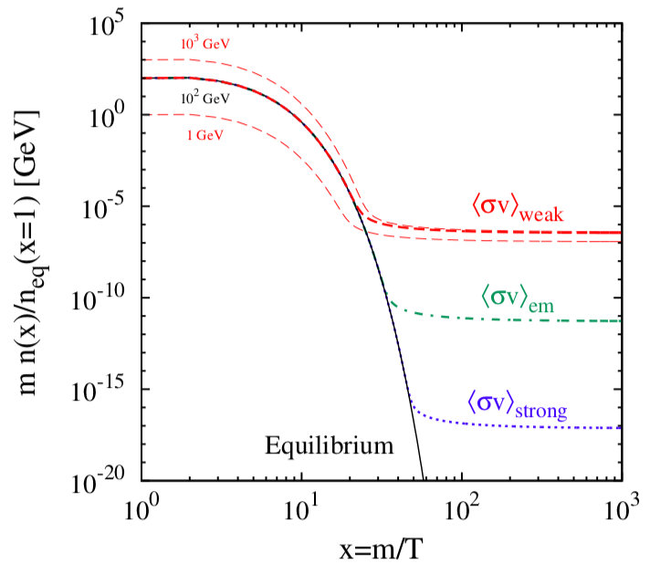
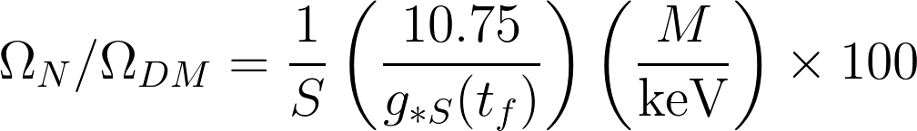
New gauge interactions (“freeze-out”)
Steigman et al. 2012
$$Γ_{N}=G_{F}^{2}{ T}^{5}{\left(\frac{m_{W}}{m_{W_{R}}}\right)}^{4}$$
$$m_{W_{R}}>1 TeV$$

Slide 23
Non-thermal Production in the decay of heavier particles
Decay far from thermal equilibrium
Decay of a heavier parent particle
Sterile neutrino in keV scale
highly relativistic
Possible decays of pions, the Higgs boson, W bosons

Slide 24
Observational evidence

Slide 25
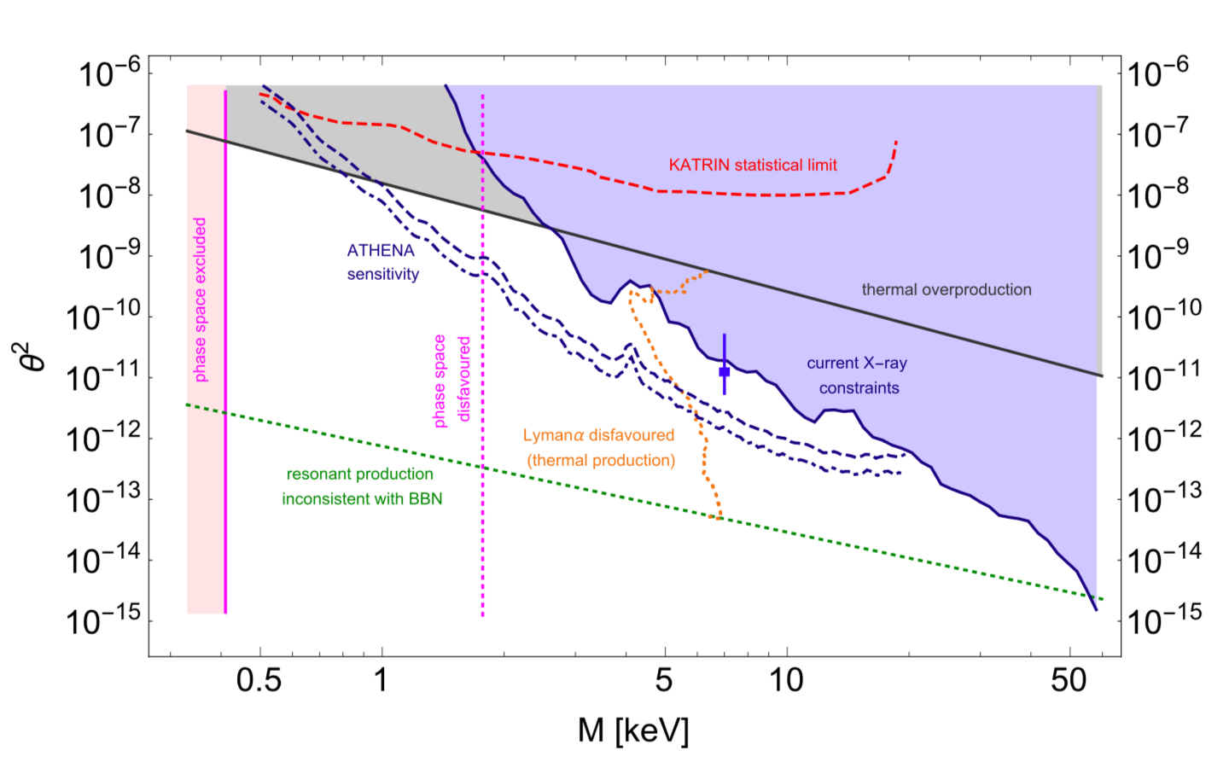
Boyarski et al. 2018

Slide 26
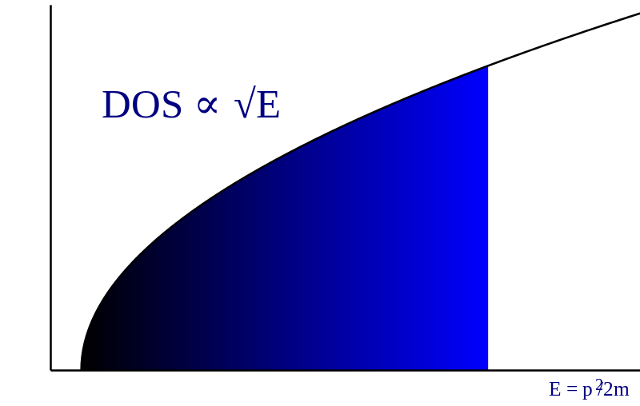
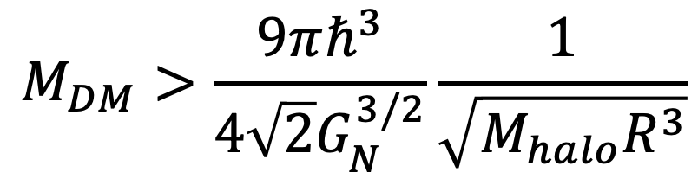
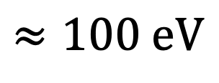
Phase space saturation
$$M_{DM}>\frac{9πℏ^{3}}{4\sqrt{2}G_{N}^{3/2}}\frac{1}{\sqrt{M_{halo}R^{3}}}$$
$$≈100 eV$$

Slide 27
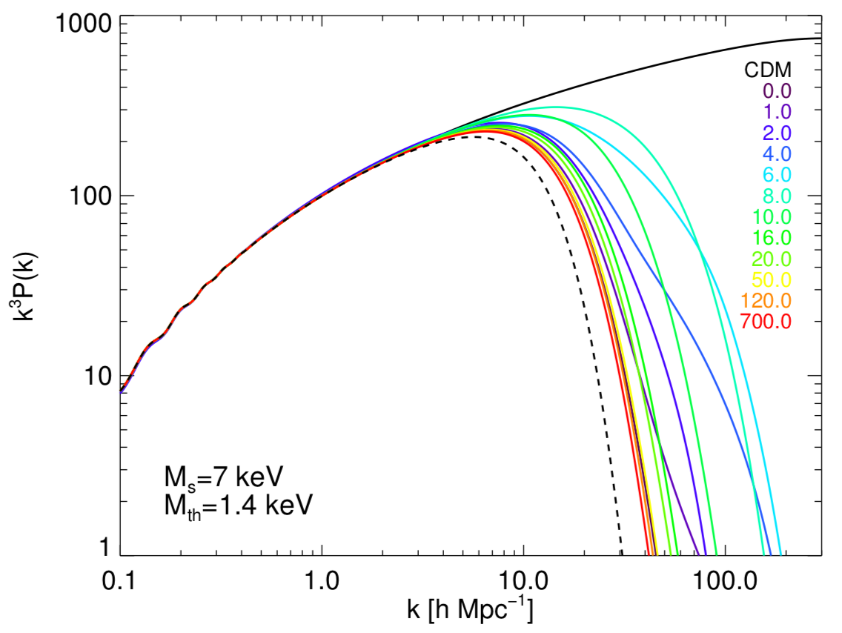
Warm dark matter
Milky Way
Boyarski et al. 2018

Slide 28
Lensing
Lensing applicable at low z
CDM/WDM difference most pronounced at high-z

Slide 29
Lensing
Counting haloes
Lensing applicable at low z
CDM/WDM difference most pronounced at high-z
Nonlinear structure formation
realization variance (possibly larger than physical effects)
Small haloes countable only for very local universe (MW, Andromeda)
Milky Way has fewer satellites than predicted
Baryonic structures may not trace DM
Effects of pressure

Slide 30
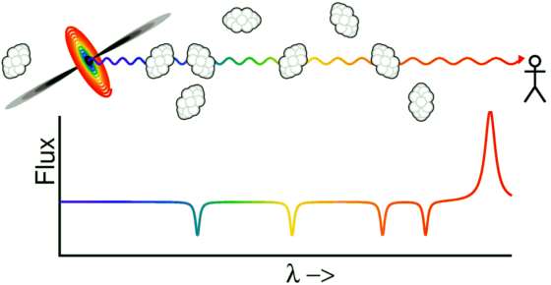
Lyman-α forest

Slide 31
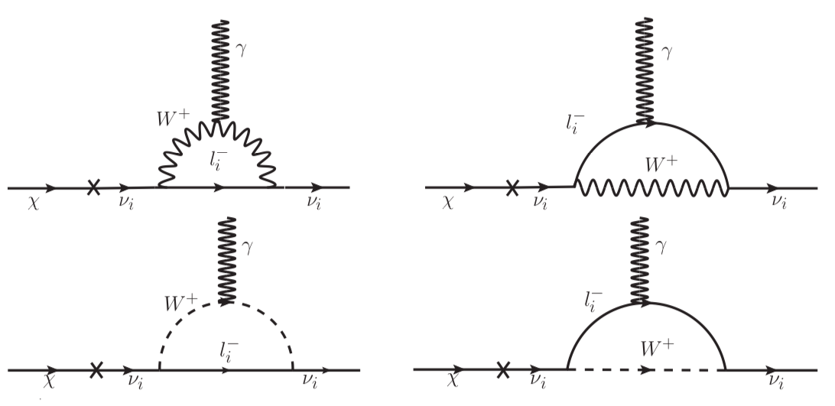
Photon emission & the 3.5 keV line

Slide 32
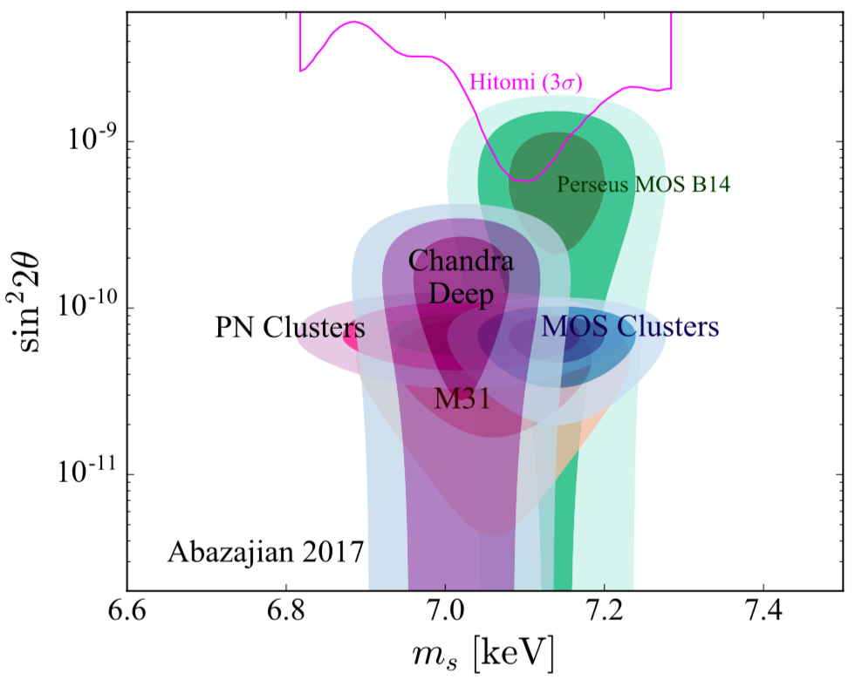
Photon emission & the 3.5 keV line
Abazajian 2017

Slide 33
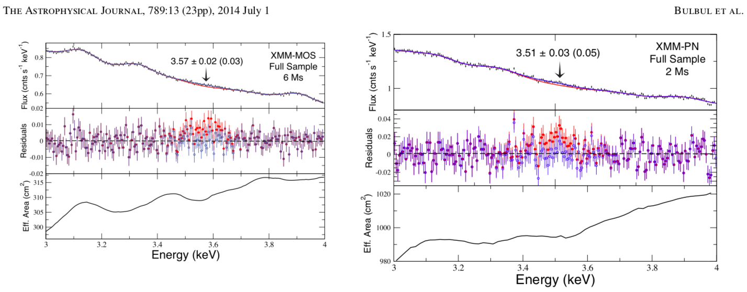
Significant?
Bulbul et al. 2014

Slide 34
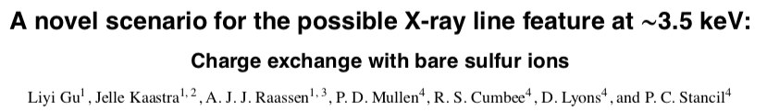

Slide 35
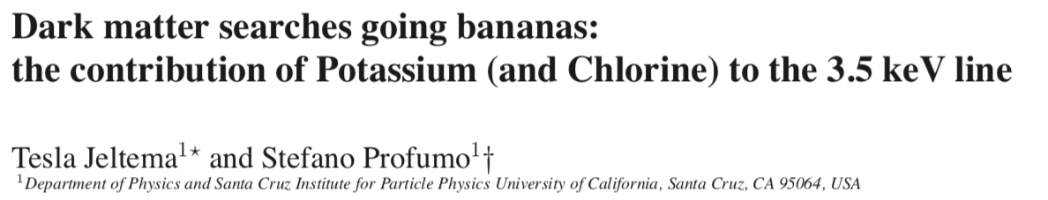

Slide 36
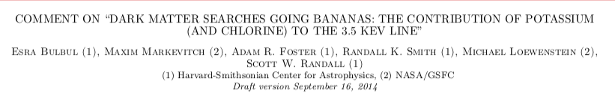

Slide 37
Boyarski et al. 2018

Slide 39

Questions?

